Slide 1
Cat and Dog Image Segmentation
James Markowitz

Slide 2
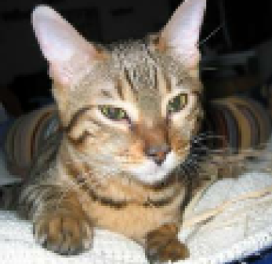

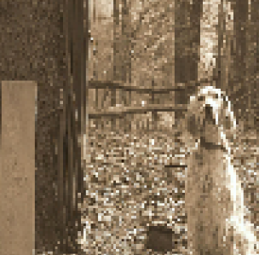
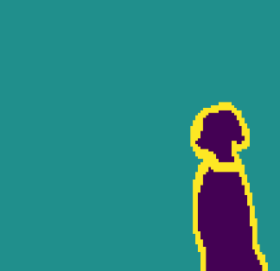
The Problem
- Given the Oxford-IIIT Pet Dataset, create a multi-class segmentation model which can tell the difference between a dog and cat pixel-by-pixel.
- Unfortunately, this dataset does not come prepared with the segmentation information required. The image mask comes only with background, foreground, and unclassified pixel-by-pixel classes. There are no identifiers between cat and dog inherent in the mask.

Slide 3
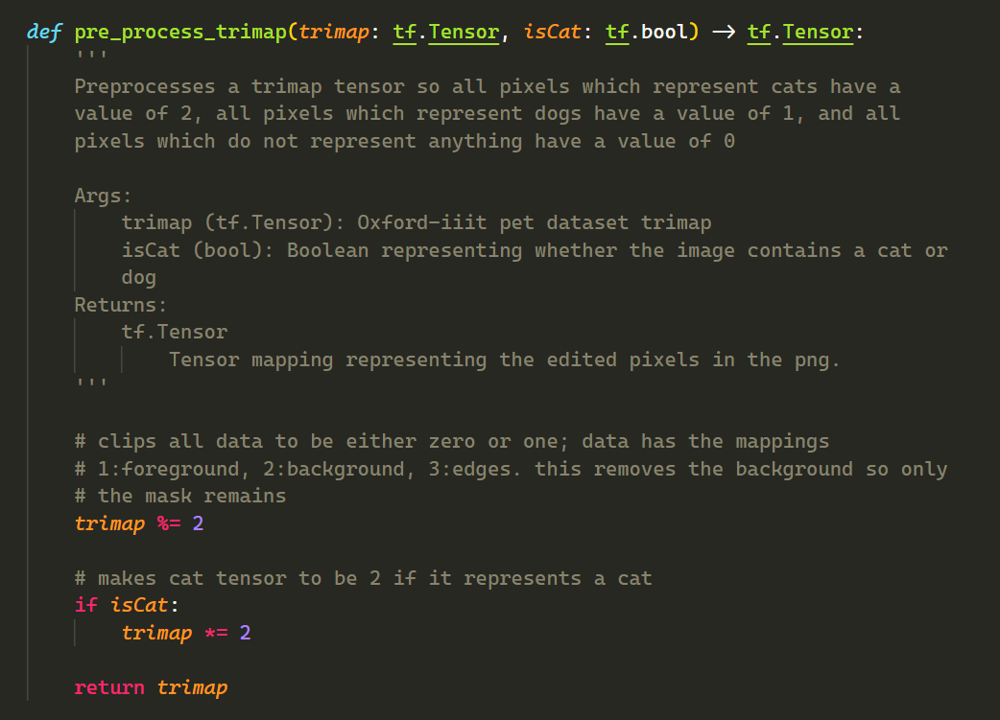

Annotating the Dataset
- Annotating the dataset to get a correct mask is pretty simple. All cats in the dataset have a corresponding image and mask which starts with a capital letter, and dogs have lowercase.
-Since the “unclassified” class is given a 2 in this dataset, taking the mod 2 of the dataset will merge edge and foreground to class 1, and the unclassified class to zero. Then, if the mask indicates a cat, simply multiply the mask by 2.

Slide 4
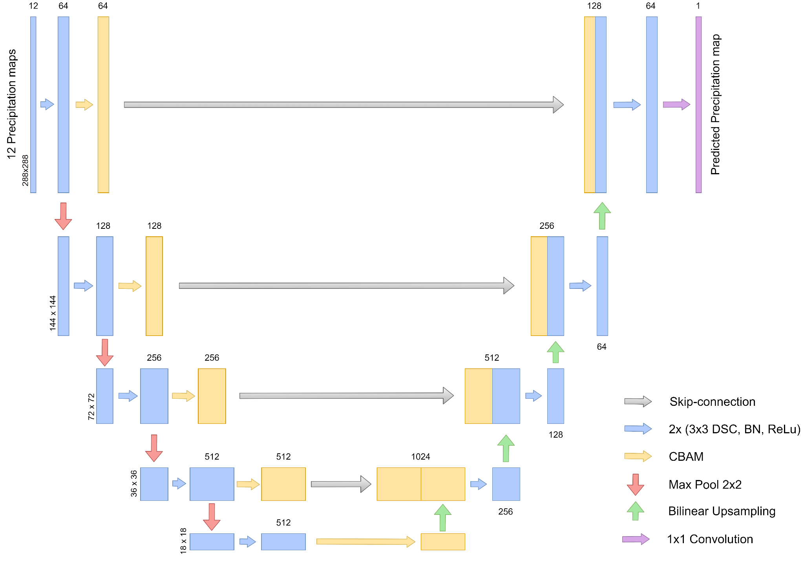
Building the Model
Pre-Trained
- With this task, I decided to go with a U-Net architecture with a pre-trained encoder. Like the picture, the model has four down convolutions and four skip-connections. Dissimilarly, my implementation has an extra up-convolution to match the input size.

Slide 5
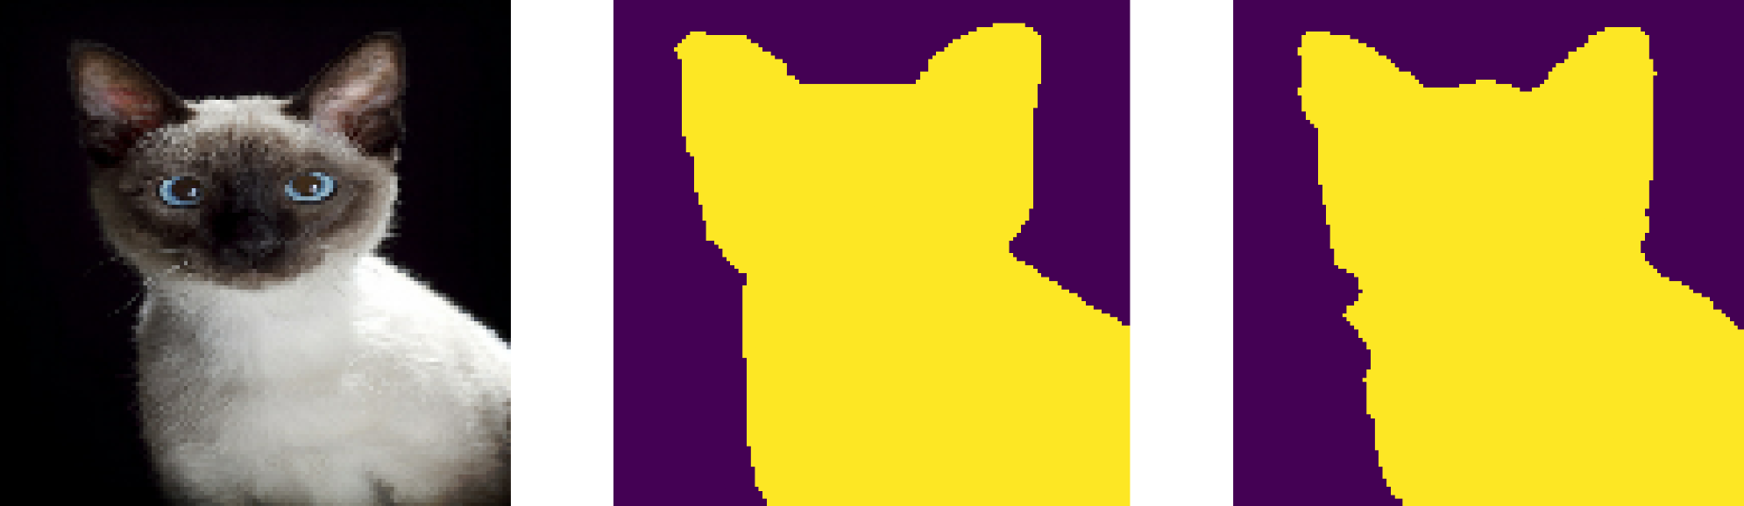
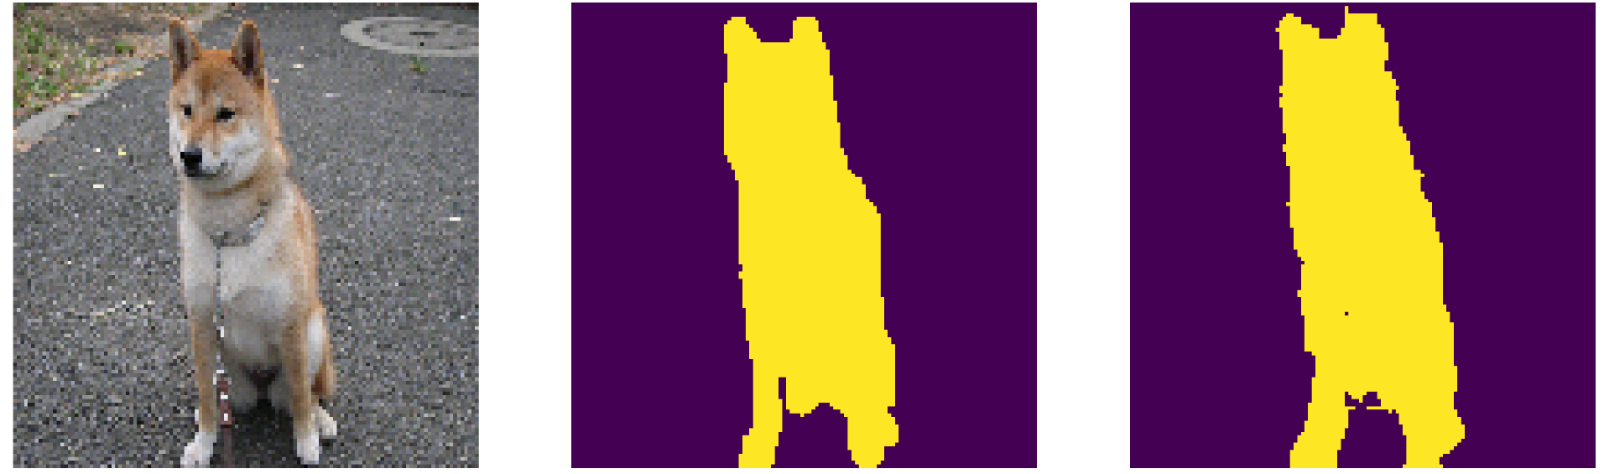
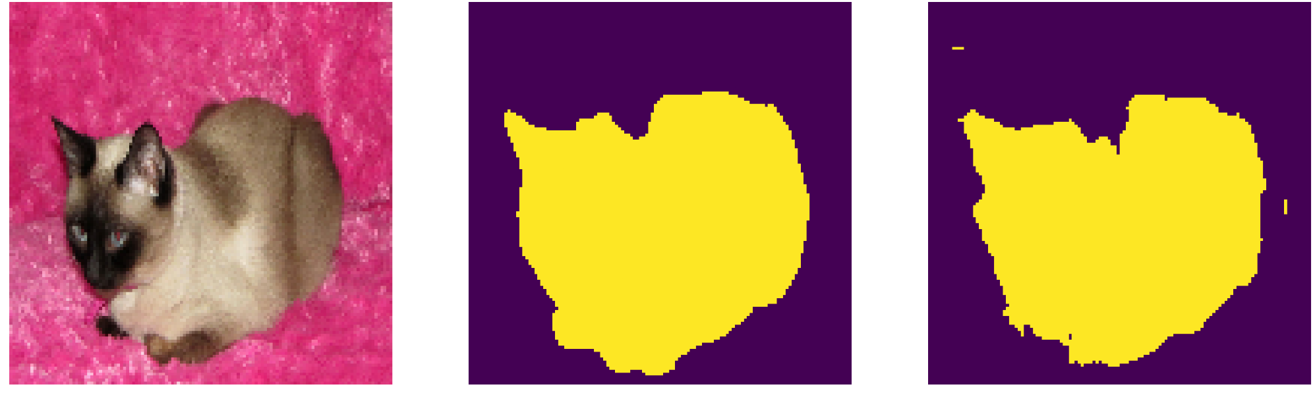
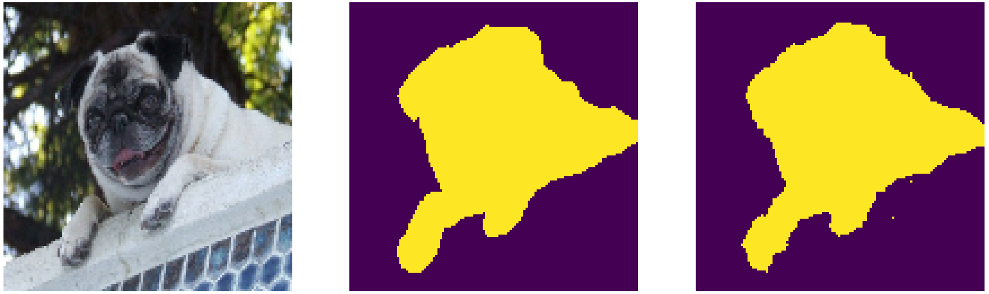
Training and Accuracy
Input
True Mask
Predicted
- After 50 epochs of training with 92 iterations each, I was able to achieve an accuracy of around 95%. (Though this is much lower for hairless cats for some reason…)

Slide 6
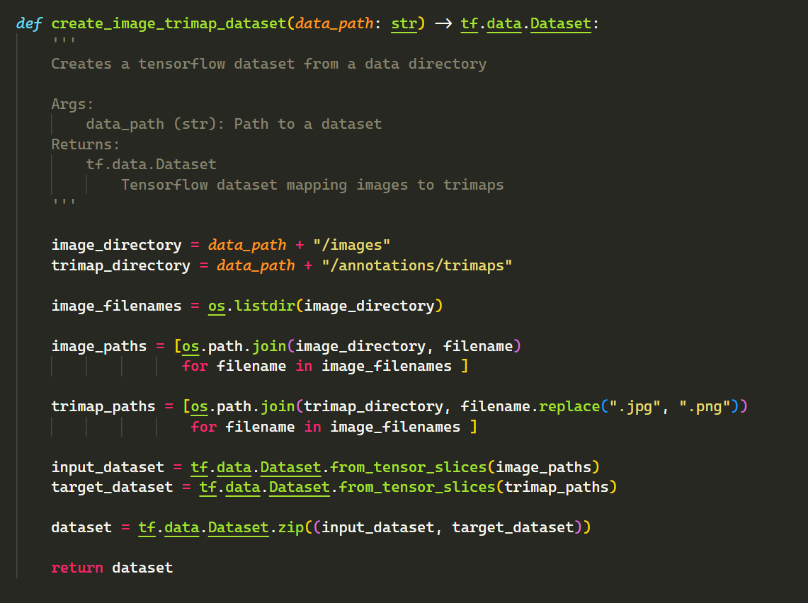
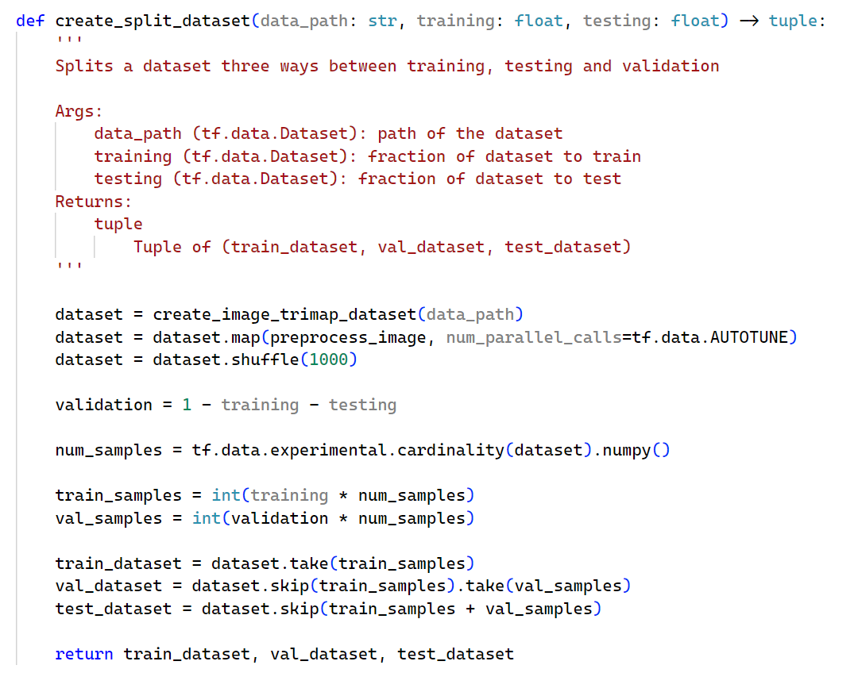
Further Application
- This multi-class segmentation problem can easily be restated to be the intubation segmentation, though with more classes and most likely a model which is more expressive.

